Slide 1
Erasmus Students Welcome Meeting
Ljubljana, 30 September 2026

Slide 2

ŠOU – STUDENT ORGANIZATION,
International Office, Pivovarniška 6, Kampus.
Office hours: please contact them by e-mail esn@sou-lj.s i
https://sou-lj.si/international/
ESN LJUBLJANA LIKE PAGE (All events will be hosted from here)
https://www.facebook.com/ESNljubljana

Slide 3
Unofficial but helpful*
ESN UNI LJ or YOLO team:
https://www.facebook.com/groups/esnljubljanauniversity
Email address: tutor@erasmusljubljana.si OR fdv.tutor@gmail.com
Website: www.erasmusljubljana.si

Slide 4
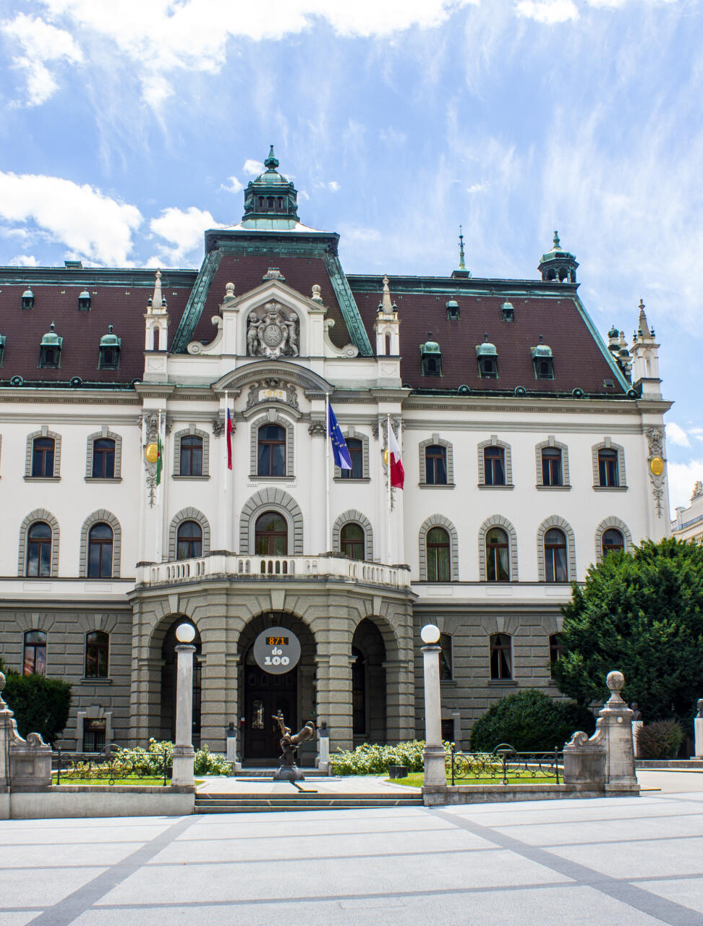
About the
University of Ljubljana
Established in 1919.
Among 500 best world's universities on the Shanghai, Times and Webometrics ranking lists.
26 full Members (3 art academies and 23 faculties)
Number of staff: 5.972
Number of students: 48.822

Slide 5
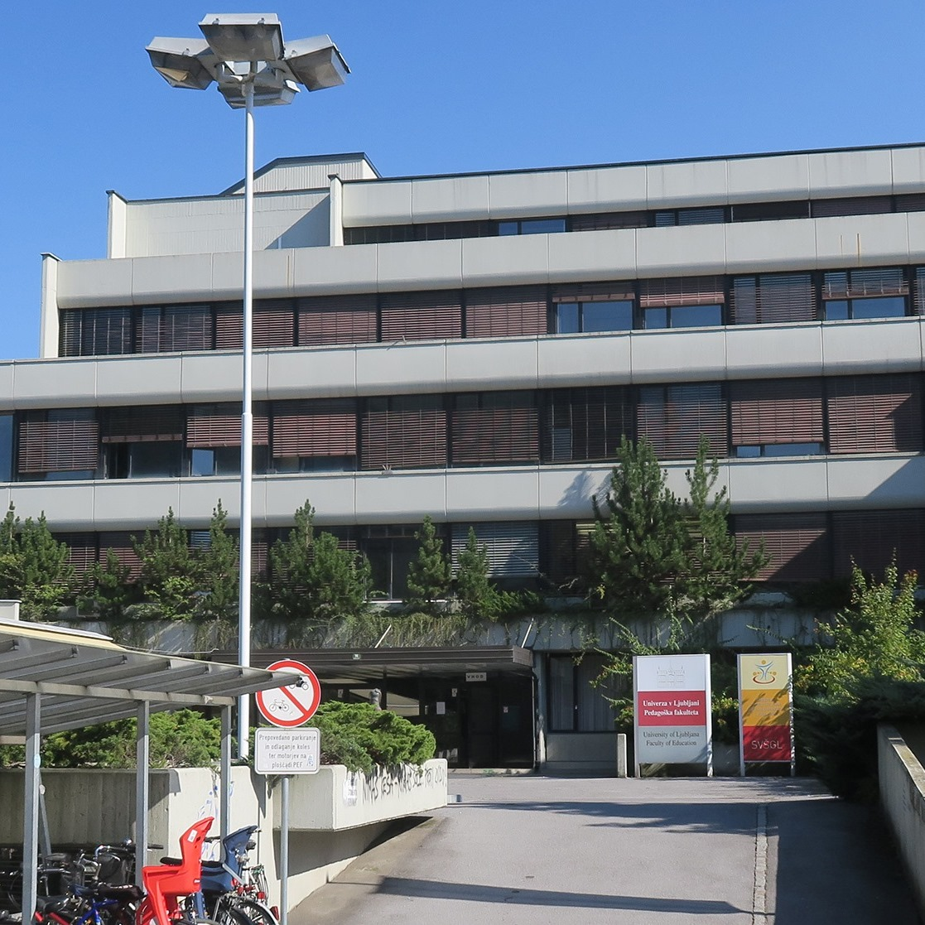
About the
Faculty of Education
App. 2.300 students
193 staff (143 teaching staff, 50 administration)
9 departments

Slide 6
Study Programmes
• 1ST CYCLE (UNDERGRADUATE STUDY PROGRAMMES)
Preschool Education, Primary Teacher Education, The Two-Subject Teacher, Art Pedagogy, Special and Rehabilitation Pedagogy, Visually Impaired Education and the Pedagogy of Specific Learning Difficulties, Social Pedagogy
• 2ND CYCLE (MASTER STUDY PROGRAMMES)
Preschool Education, Primary Teacher Education, Primary Teacher education with English specialisation, Subject Teacher Education, Art Pedagogy, Special and Rehabilitation Pedagogy, Speech and Language Therapy, Social Pedagogy, Supervision, Personal and Organisational Counselling, Cognitive Science (Joint Degree), Arts Therapy, Museum Education, Educational Policies
• 3RD CYCLE (DOCTORAL STUDY PROGRAMME)
Teacher Education and Educational Science

Slide 7
Office for International Co-operation
Room 034
Tel: +386 1 5892 346
Fax: +386 1 5892 233
E-mail: international@pef.uni-lj.si
Opening hours:
Monday and Friday 8:30 - 11:30
Wednesday 12:30 - 15:30
Igor Repac
Robert Gracar

Slide 8
Practical Information
WELCOME MEETING FOR FOREIGN STUDENTS
(16 September 2026)
Recording of the zoom welcome meeting with practical information on residence permit, student meals, Urbana card ....
Welcome day for International students 2026 | University of Ljubljana

Slide 9
First Residence Permit:
If you are staying in Slovenia for more than 3 months you have to apply for the First Residence Permit (and report your temporary address if you are staying in a private flat) as soon as possible after the arrival.
See: https://www.uni-lj.si/en/study/international-students/temporary-residence-permit
SPECIAL DESK FOR EXCHANGE STUDENTS from 22 September 2026 until 9 October 2026, open: Monday, Tuesday and Wednesday from 10am to 2pm, Friday from 9am to 12pm
During this period in which the Special desk is in operation, it is not necessary to book an appointment at the Administrative Unit. After October 9, you must make an appointment

Slide 10
Student meals (from 1. 10. 2026)
Procedure:
You need your mobile phone with mobile data or Slovene SIM card. You can also get a special card used only for the food system, 1-2 days to be operative;
Register on-line: https://www.studentska-prehrana.si/en
For the final registration go to INFO Point at Pivovarniška 6, (Wed 9 am- 3.30 pm);
e-mail contact: studentska.prehrana@sou-lj.si or ESN office (Pivovarniška 6 – pink doorJ)
You also need EMŠO number (unique personal number – 13 digit number starting with your date of birth ) – provided by the faculty- please contact your faculty coordinator . You will get app. 20 subsidies per month. You can use the system twice a day (4 hours break between the meals), from 7 am until 12 pm, also during weekends .

Slide 11
STUDENT BUS CARD
(URBANA TIME CARD - green)
20 € per month (the pass is valid from the first day of the month until the first day of the next month, ex. 1 October -1 November)
With your personal ID document or passport and equipped with EMŠO number, go to this address: Slovenska cesta 56, Ljubljana – office hours 8 am to 3.30 pm; WED until 5pm; main Bus Station, Trg OF 4, 6 am – 8pm.
If you think you will not use the bus often, you can get Urbana value card – yellow (one ride costs 1.50€) – you can purchase it in any kiosk or at the post office. The card itself costs 2€.
http://www.jhl.si/en/single-city-card-urbana
PLEASE start arranging only from 1 October on!

Slide 12
Health problems
If you get sick or have a toothache, you should visit:
ZDRAVSTVENI DOM ZA ŠTUDENTE (Health Centre for students)
International Students - Zdravstveni dom za študente Univerze v Ljubljani
Aškerčeva 4, 1000 Ljubljana
Choose a doctor from the list on the web page and call for an appointment or book it online (https://www.zdstudenti.si/en/information-for-patients/appointments/).
You need to bring your European Health Insurance Card or your insurance policy!

Slide 13
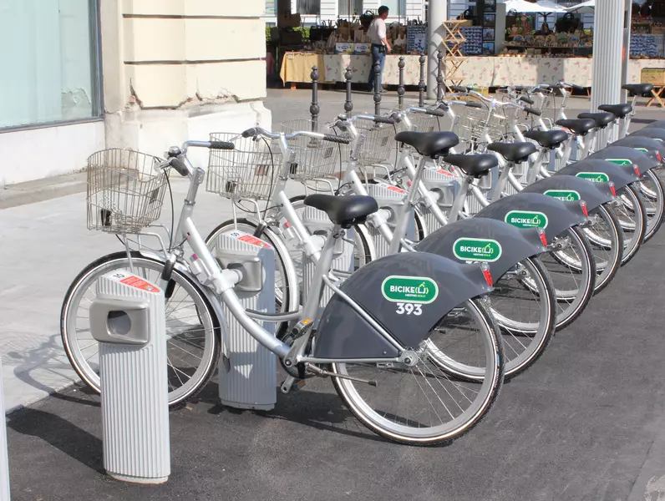
Self-service bike borrowing system “BICIKElj” for only 3 EUR/year
Easiest way to travel around Ljubljana is with free-of-charge bicycle rental Bicikelj, it requires prior registration at http://en.bicikelj.si/ and any kind of Urbana card.

Slide 14
Center for Extracurricular Activities – FREE sport activities
● Contact: University sports hall Rožna dolina, Svetčeva 11,
phone 01/241 86 36, cod@uni-lj.si
● FB https://www.facebook.com/cod.sportul
● INSTA https://www.instagram.com/ul.cod/
● WWW https://www.uni-lj.si/extracurricular_activities/

Slide 15
Center for Extracurricular Activities – FREE sport activities
Presentation of Sports and Other Extracurricular Activities:
Date: 9th October 2026 at 11 am
Location: University Sports Hall Rožna dolina, Svetčeva 11
Registration: https://popr.uni-lj.si

Slide 16
PSYCHOSOCIAL COUNSELLING SERVICE
https://www.uni-lj.si/en/university/equality-and-inclusion/psychosocial-counselling-service
In Case of Emergency:
Crisis Intervention Service in Ljubljana, Grablovičeva 44a, telephone (01) 5874 922
Centre for Outpatient Psychiatry, Njegoševa 4, Ljubljana, telephone (01) 4750 685.

Slide 17
TEMPORARY STUDENT JOBS
You can work via Student Service if you have student status in Slovenia or if you are doing your practice or studies as a part of an international exchange programme in Slovenia https://www.studentski-servis.com/studenti/foreigners
You will have to open bank account in any of the banks here.
For opening a bank account, you will need Slovenian tax number.
  You can get it here (tax number): Davčni urad Ljubljana, p. p. 107, 1001 Ljubljana

Slide 18
Erasmus documentation
Confirmation of Stay
Learning Agreement
Transcript of Records

Slide 19
Confirmation of Stay
Must be signed on first and last day(!) of mobility.
It is used to calculate the Erasmus scholarship based on the number of days on mobility.
Usually each University has its own form.
Real date of departure! Signed in person in the office.

Slide 20
Learning agreement
Changes still possible until October 16.
Changes have to be requested by e-mail: international@pef.uni-lj.si
Don‘t forget: changes must be approved by your home coordinator as well.

Slide 21
Transcript of Records
Issued at the end of your exchange by the international office; instead of last part of Learning agreement.
You have to request it by email at the international office once you have all the grades in the information system.
Sometimes Erasmus students return home before the grades are in the system.

Slide 22
Other documentation:
Personal registration number (EMŠO)
Instructions for activation of your UL Digital Identity
Student Card

Slide 23
Personal Registration Number (EMŠO)
The EMŠO is a personal identification number in the Republic of Slovenia. It is entered in official records and other databases when so stipulated by the law. You will need it, for example, for buying Urbana student bus card etc.

Slide 24
Your UL Digital Identity
You need the UL ID to access the systems and services during your studies at UL PEF:
Student Information System - VIS (application for exams, grades)
UL PEF Online Classroom - Spletna učilnica PEF,
Use of computers in the lobby of UL PEF,
Computer classrooms at UL PEF,
EduRoam wireless internet network
Services provided to students by the University of Ljubljana: Email, Office 365 (MS Teams!), E-notifications (e-obvestila)
More information: https://www.pef.uni-lj.si/en/exchange-students/information-services-for-students/

Slide 25
Your UL Digital Identity
Your UL digital identity is comprised of your username and your password. The username resembles an email address, e.g. jn1234@student.uni-lj.si.
You must first activate your identity at a special portal - you received your username. Follow the instructions for ID activation!
In case you have any problems use the Helpdesk.

Slide 26
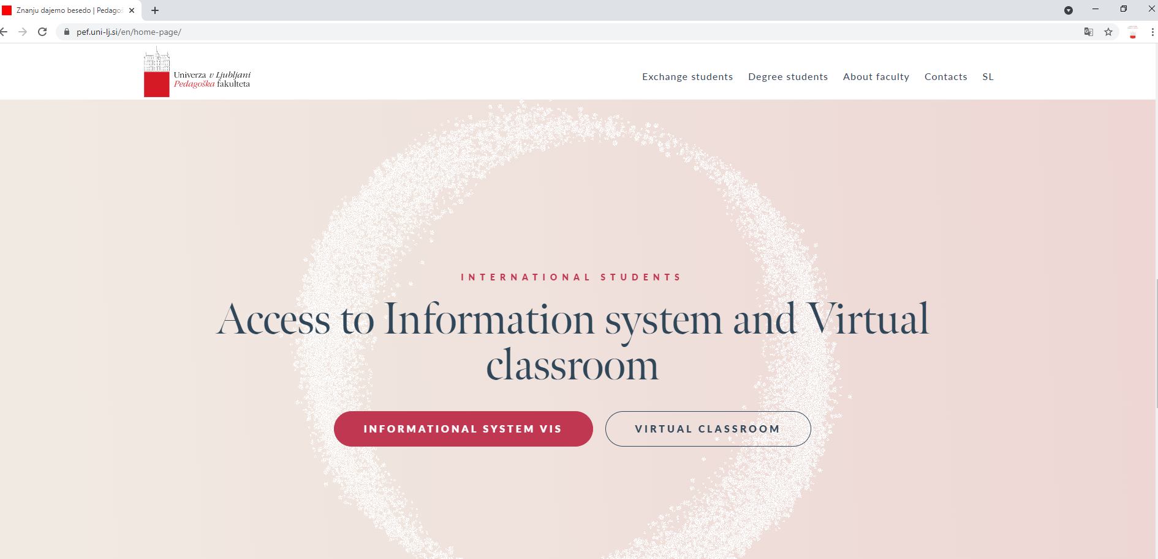
https://www.pef.uni-lj.si/en/home-page/

Slide 27
Student Information System (VIS)
The System includes:
My Data (Important: please check if you have all your chosen courses enabled in the information system!)
Exams (exam dates & registration – 3 days before the exam!)
Grades

Slide 28
Virtual Classroom („Moodle“)
Virtual Classroom is used by professors in the courses (for literature, assignments etc.). Use your University ID to access it.
Some courses are additionally locked by „enrolment key“. Each professor will give it to you.

Slide 29
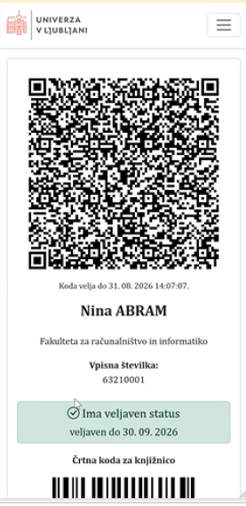
Student Card
On 25 September 2026, the University of Ljubljana introduced a new functionality to the production environment of its ID Portal, enabling University of Ljubljana students to access a digital proof of student status. The proof is available through the University of Ljubljana ID Portal after signing in with a digital student identity (username and password) and is optimized for use on mobile devices.
It contains a dynamic QR code for verifying the validity of a student's status and a barcode with the student identification number for identification purposes and registration at University of Ljubljana libraries. The QR code remains valid for 60 minutes and enables secure and reliable verification of student status.

Slide 30
SCHEDULE
https://www.pef.uni-lj.si/en/exchange-students/courses-in-english/

Slide 31
LIBRARY
Librarian for Erasmus students – Milena Repa
milena.repa@pef.uni-lj.si

Slide 32
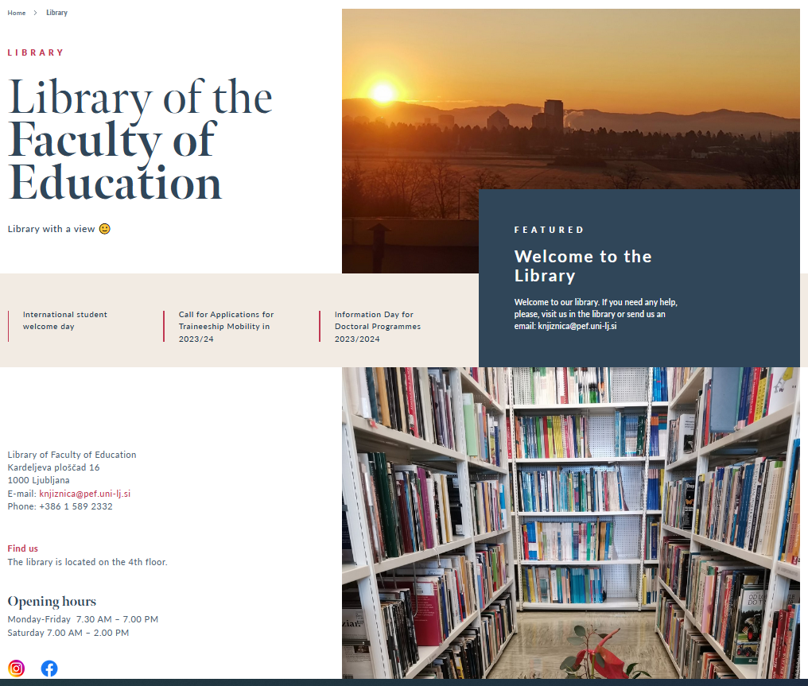
4th floor
Monday to Friday
7.30 – 19.00
Saturday
7.00 – 14.00
LIBRARY

Slide 33
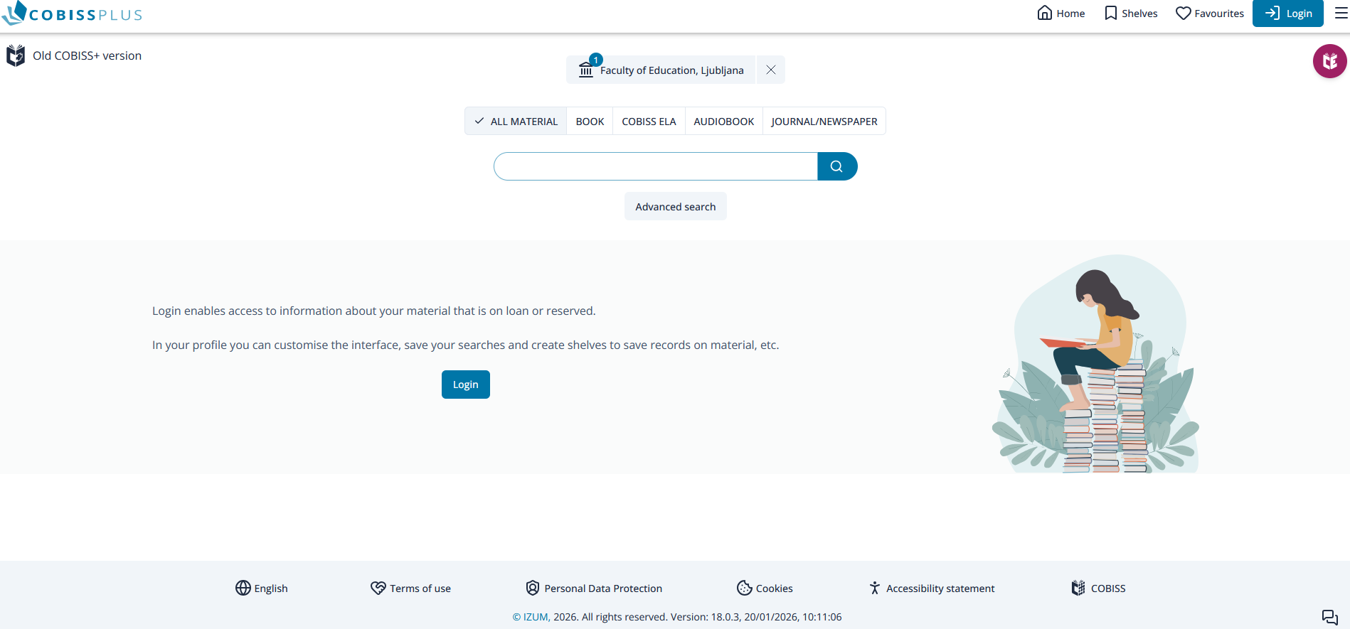
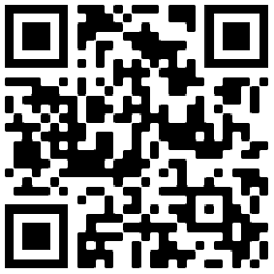
COBISS Plus
National library management system
Choose Faculty of Education, Ljubljana
or write peflj
Online registration
Language English
Login

Slide 34
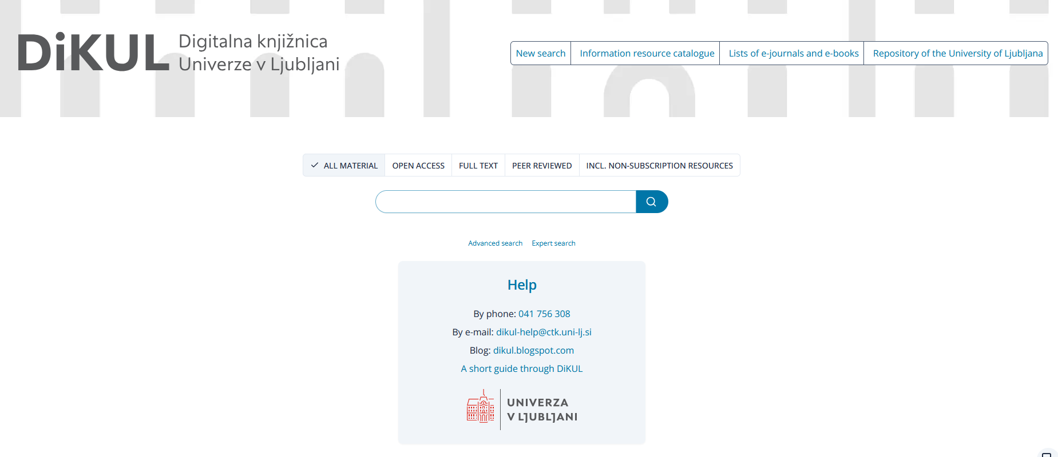
DiKUL - Digital library of University of Ljubljana
Access to foreign (academic) journals and e-books from different academic and scientific fields
Full text articles, open access
Remote access with your digital identity

Slide 35

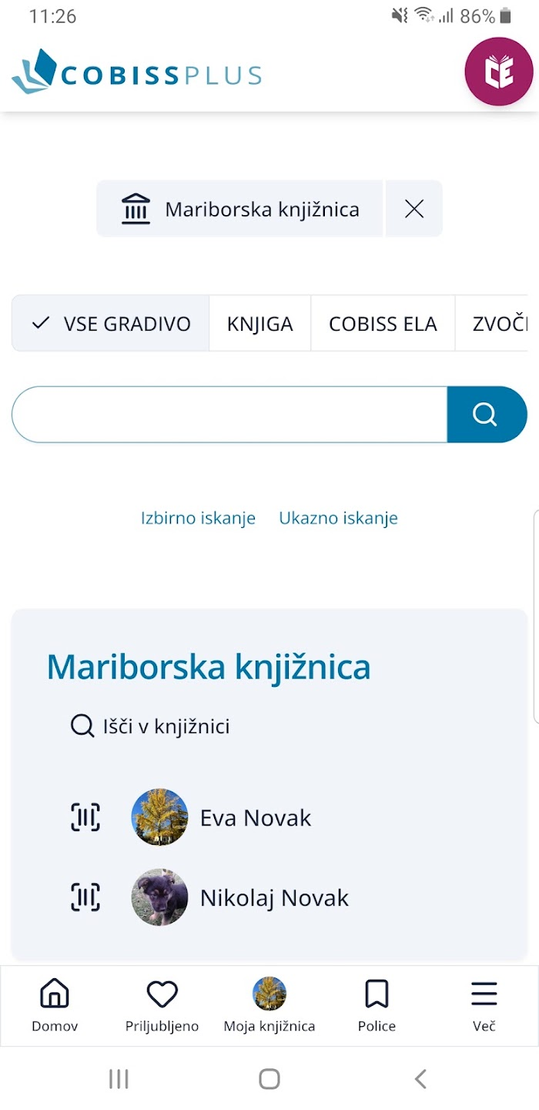

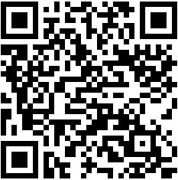

COBISS Plus
For reserving or renewing books

Slide 36
LIBRARY EDUCATION SERVICES
Welcome to individual or group training for library use.
We adjust training to individual groups, background knowledge and agreed topic area.
Send us an email on knjiznica@pef.uni-lj.si or ask in the library.

Slide 37
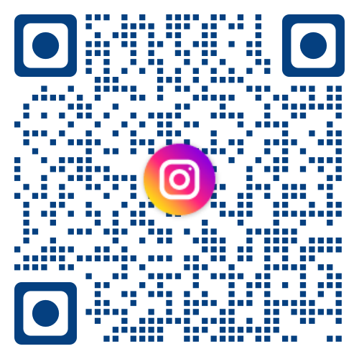


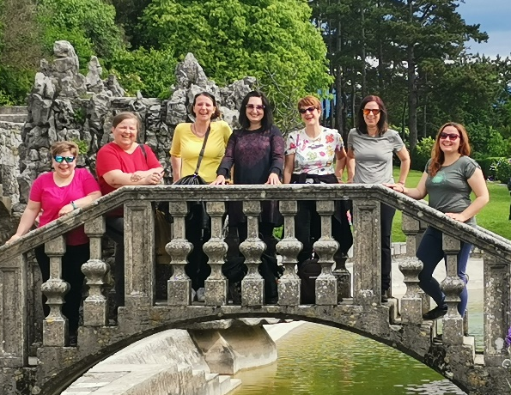

WELCOME TO THE LIBRARY!
Books for leisure time in English
Reading room for studying
Print journals in English
Friendly librarians ☺
knjiznica.pef
Knjižnica UL PEF

Slide 38
Special request:
Research Study on Erasmus+ Mobility
By sharing your experience, you can contribute to a better understanding of how international mobility supports students’ personal and professional development.
How to participate?
Next week, you will receive an email with a link to a short online questionnaire.
A study on Perceptions of Students in Teacher Education Programmes of the Development of Plurilingual, Intercultural, and Professional Competences through Erasmus+ Study Mobility
Ms. Gaja Kocijančič
Master's student at the Faculty of Education, University of Ljubljana

