Slide 1

Welcome to Ljubljana!
ESN Ljubljana

Slide 2

What does our office provide?
subsidized student meals system
private student accommodation search help
document support
events and trips registration
ESN card provider
help with any other matter regarding your stay or education in Slovenia
LOCATION: Študentski kampus, Pivovarniška ulica 6, 1000 Ljubljana

Slide 3

Subsidized student meals system
EMŠO number (Unique personal identification number)
First enrollment: https://www.studentska-prehrana.si/en/Account/Register
mobile phone
mobile APP – Student meal APP (iOS) & Študentska prehrana (Google Play)
personal ID or passport

Slide 4
Private student accommodation
our accommodation email address: rooms@sou-lj.si
ESN Ljubljana Telegram private accommodation chat: https://t.me/+o6tq3s8bWJdhODdk
websites and Facebook groups: https://linktr.ee/accommodationljubljana
price
University accommodation website: www.uni-lj.si/study/information/accommodation

Slide 5

ESNcard
membership discount card (international)
discounts with the ESN card:
  Ryanair,
  Flixbus,
  Zalando,
  Eurosender,
  more useful discounts at www.esncard.org

Slide 6

Ljubljana Erasmus discount card
membership discount card (local)
discounts with the Ljubljana Erasmus discount card:
  events and trips organised by ESN Ljubljana,
  RENTY rent-a-car,
  GoOpti airport shuttle, …

Slide 7
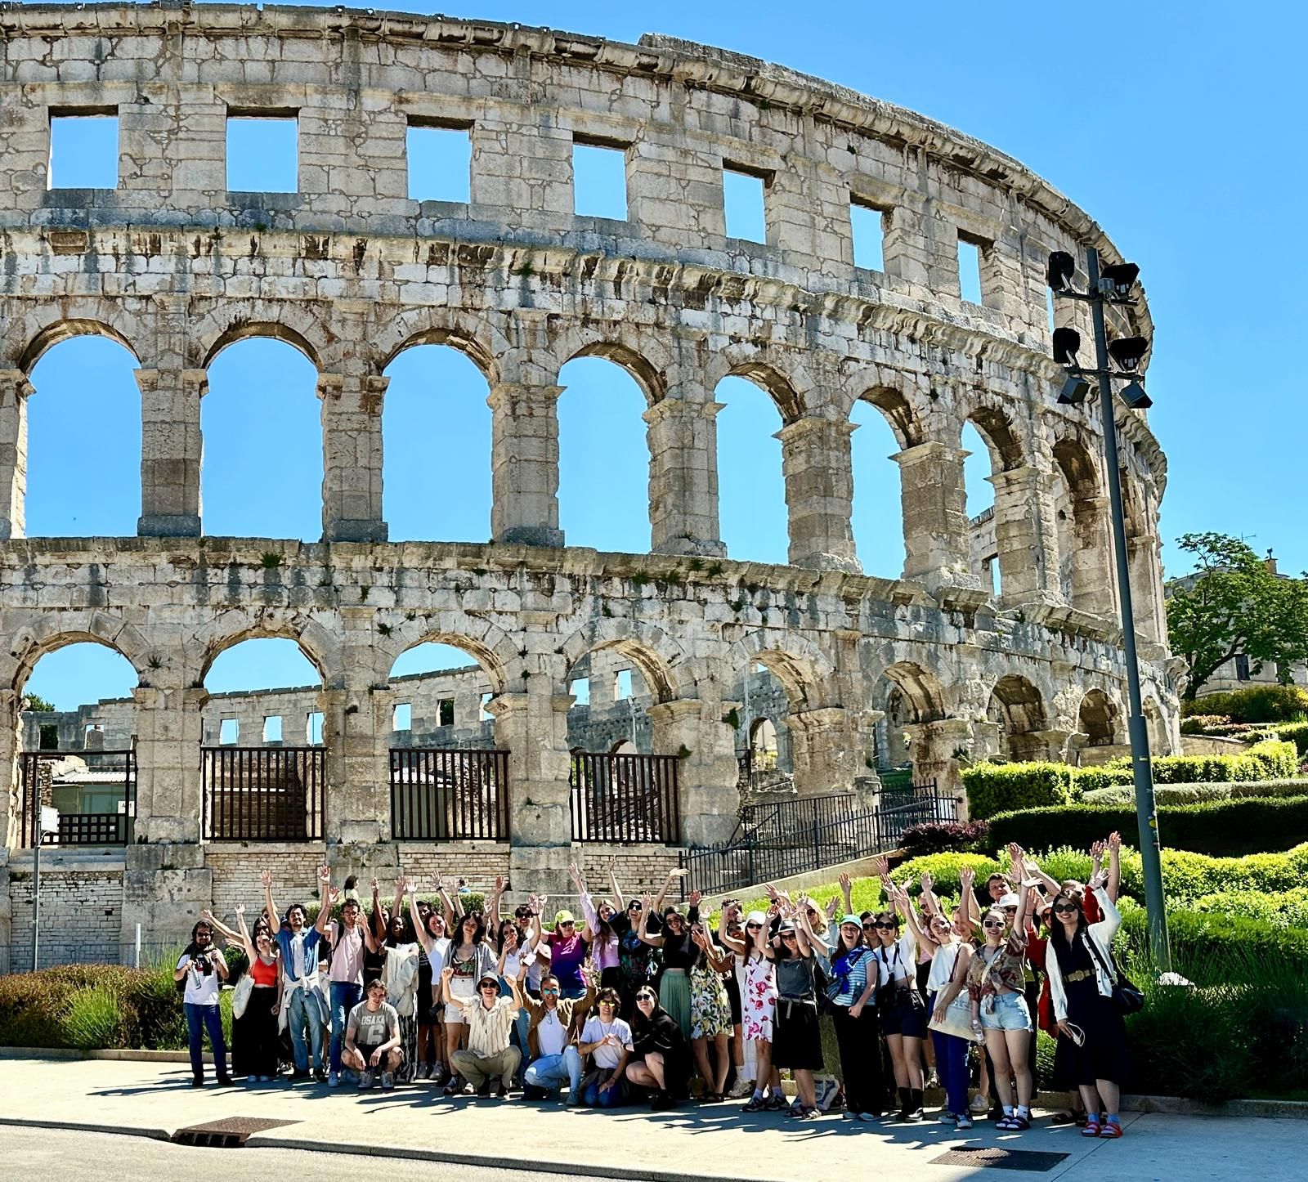
Events and trips
Welcome weeks
educational workshops and lectures
sports events and attendance of sports competitions in Ljubljana
other one-day events
one-day and multi-day trips around Slovenia and Europe

Slide 8
Trips itinerary
19.09.2026 – Alpine trip – SOLD OUT
26.09.2026 – Coast trip – SOLD OUT
03.10.2026 – Lake trip – SOLD OUT
10. – 11.10.2026 – Trip to Bologna, Rimini & San Marino – SOLD OUT
17.10.2026 – Cave trip – SOLD OUT
24.10.2026 – Trip to Savinjska region – 2nd BUS FIRST SPOTS SOLD
31.10. – 1.11.2026 – Trip to Belgrade – 2nd BUS MORE THAN HALF FULL
07.11.2026 – Trip to Venice– 2nd BUS FIRST SPOTS SOLD
14. – 15.11.2026 – Trip to Zagreb & Plitvice lakes
20. – 22.11.2026 – Balkan trip – 1 OCTOBER APPLICATIONS OPEN
28.11.2026 – Trip to Salzburg
04. – 06.12.2026 – 3 days 3 capitals trip
13.12.2026 – Trip to Graz
??? – Erasmus ski trip

Slide 9
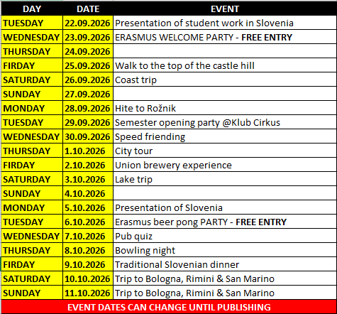
Welcome weeks & events
Telegram CHANNEL (publishing of events and updates)
events almost every day
some events have very limited spots
for more information: esnlj.events@gmail.com

Slide 10
Event and trip payment
Ljubljana Erasmus discount card
  For discounts to be valid, you need to acquire your Ljubljana Erasmus discount card before the first event you will attend while using the discount, otherwise you will need to pay the difference to the full price at the spot.
ESN Ljubljana office (during office hours)
  with cash
  with payment card (for trips only)
Online payment
  using one of the available payment methods on Fienta
bank transfer
  For bank details please always write to our events email address esnlj.events@gmail.com, as bank details for bank transfers are different between some events and trips.

Slide 11
Public transport
public city bus transport (LPP)
20,00 EUR / monthly ticket
  LPP passenger center (Slovenska cesta 56, 1000 Ljubljana) – opening hours from Monday to Friday from 6:30 to 15:30, and on Wednesday from 6:30 to 17:00
public bikes (BicikeLJ)
  3,00 EUR / yearly fee
Urbana app (for bus schedule, single bus tickets, parking payment, … )
Get your own bike (bolha.com, bike repair shops)

Slide 12
Healthcare & residence permit
EMERGENCY NUMBERS: 112 and 113
Students healthcare center (Aškerčeva cesta 4, 1000 Ljubljana)
Residence permit information: https://www.uni-lj.si/en/study/international-students/temporary-residence-permit
Special desk for exchange students (Tobačna ulica 5, 1000 Ljubljana)
22 September – 9 October 2026 (Monday, Tuesday, Wednesday from 9am to 2pm; Friday from 9am to 12pm)

Slide 13
ESN Ljubljana
our email address: esn@sou-lj.si
ESN Ljubljana 2026/27 – Official Telegram CHANNEL: https://t.me/esnljubljana2026_27
ESN Ljubljana 2026/27 – Official Telegram CHAT GROUP: https://t.me/+q9msEI7Y2royNDQ0
Events registration website: https://esn-sou-lj.si/
Facebook (@esnljubljana): https://www.facebook.com/esnljubljana
Instagram (@esnljubljana): https://www.instagram.com/esnljubljana/
all important links at one place – LinkTree: https://linktr.ee/esnljubljana
ESN Ljubljana office hours are available on LinkTree

Slide 14
THANK YOU!

