Slide 1

Erasmus Students Welcome Meeting
Ljubljana, 15 February 2024

Slide 2

Erasmus Student Network
ESN Ljubljana University:
e-mail: tutor@erasmusljubljana.si or fdv.tutor@gmail.com
Web: https://www.erasmusljubljana.si/
Tutor Student at the Faculty of Education: tutorpef@gmail.com

Slide 3
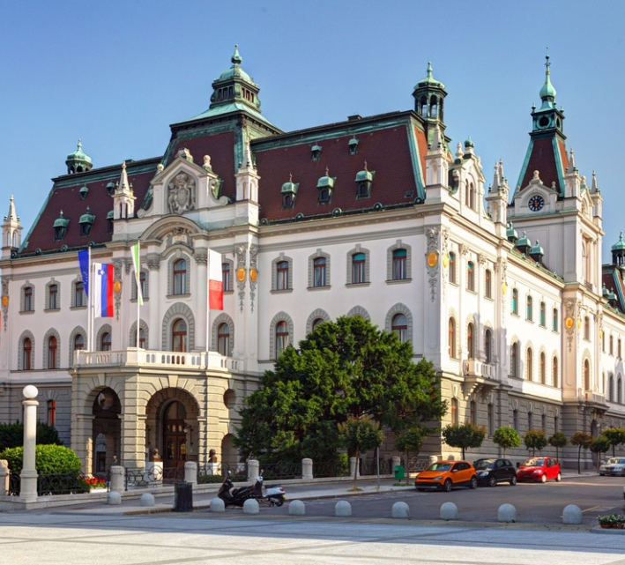
About the University of Ljubljana
Established in 1919.
Among 500 best world's universities on the Shanghai, Times and Webometrics ranking lists.
26 full Members (3 art academies and 23 faculties)
Number of staff: 5.972
Number of students: 48.822

Slide 4
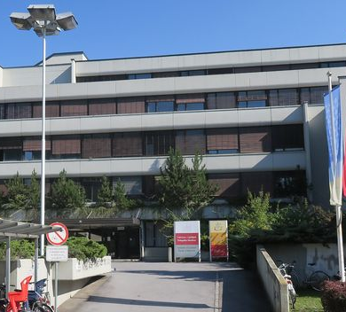
About the Faculty of Education
App. 2.500 students
193 staff (143 teaching staff, 50 administration)
9 departments

Slide 5
About the Faculty of Education
• 1ST CYCLE (UNDERGRADUATE STUDY PROGRAMMES)
Preschool Education, Primary Teacher Education, The Two-Subject Teacher, Art Pedagogy, Special and Rehabilitation Pedagogy, Visually Impaired Education and the Pedagogy of Specific Learning Difficulties, Social Pedagogy
• 2ND CYCLE (MASTER STUDY PROGRAMMES)
Preschool Education, Primary Teacher Education, Primary Teacher education with English specialisation, Subject Teacher Education, Art Pedagogy, Special and Rehabilitation Pedagogy, Speech and Language Therapy, Social Pedagogy, Supervision, Personal and Organisational Counselling, Cognitive Science (Joint Degree), Arts Therapy, Museum Education, Educational Policies
• 3RD CYCLE (DOCTORAL STUDY PROGRAMME)
Teacher Education and Educational Science

Slide 6

Office for International Co-operation
Room 034
Tel: +386 1 5892 346
Fax: +386 1 5892 233
E-mail: international@pef.uni-lj.si
Opening hours:
Monday and Friday 8:30 - 11:30
Wednesday 12:30 - 15:30
Igor Repac
Robert Gracar

Slide 7

Practical Information
WELCOME MEETING FOR FOREIGN STUDENTS (15 September 2023) - recording of the zoom welcome meeting with practical information on residence permit, student meals, urbana card ....
https://www.uni-lj.si/study/news/reception/

Slide 8

First Residence Permit:
If you are staying in Slovenia for more than 3 months you have to apply for the First Residence Permit (and report your temporary address if you are staying in a private flat) as soon as possible after the arrival.
Together with Administrative Unit we will organize SPECIAL DESK from 12 to 23 February 2024 for exchange students. The Administrative Unit and our International Student Ambassadors will welcome you:
  Monday to Thursday- from 10am to 2pm
  Friday- from 9am to 12pm
Address: Administrative Unit Ljubljana, Tobačna 5
More information: TEMPORARY RESIDENCE - INTERNATIONAL STUDENTS (uni-lj.si)

Slide 9
Student meals (from 19. 2. 2024)
You need your mobile phone with mobile data or Slovene SIM card. (Free SIM cards should also be available at the Student Organization of the University – ŠOU, Pivovarniška 6, Kampus, office hours Monday, Tuesday, Thursday: 16.00 - 19.00); you can also get a special card used only for the food system – 15€ non-refundable, 1-2 days to be operative;
Register on-line: www.studentska-prehrana.si
For the final registration go to INFO Point at Pivovarniška 6, (Mon 9am-3.30pm, Wed 9am-3.30pm); e-mail contact: studentska.prehrana@sou-lj.si or ESN office (Pivovarniška 6 – pink door)
You also need EMŠO number (unique personal number – 13 digit number starting with your date of birth) – provided by the faculty- please contact your faculty coordinator https://www.uni-lj.si/international_cooperation_and_exchange/erasmus-plus-programme/erasmus_plus_coordinators/
You will get app. 20 subsidies per month. You can use the system twice a day (4 hours break between the meals), from 8am until 9pm, also during weekends.

Slide 10
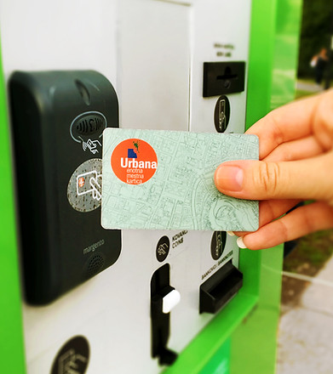
STUDENT BUS CARD
(URBANA TIME CARD - green)
20 € per month (the pass is valid from the first day of the month until the first day of the next month, ex. 1 October -1 November)
With special form: Subsidized monthly pass application form, filled in and equipped with EMŠO number, go to this address: Slovenska cesta 56, Ljubljana – office hours: 6.30 am – 7 pm, or main Bus Station, Trg OF 4, 6 am – 8 pm. You don’t need the signature or stamp of the faculty!
If you think you will not use the bus often, you can get Urbana value card – yellow (one ride costs 1.30€) – you can purchase it in any kiosk or at the post office. The card itself costs 2€. http://www.jhl.si/en/single-city-card-urbana

Slide 11
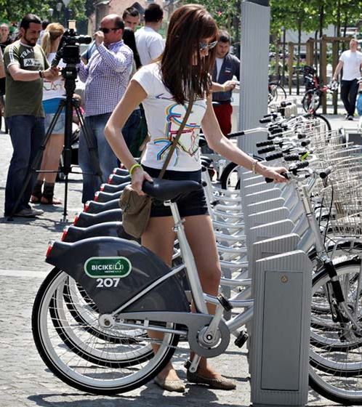
SELF-SERVICE BIKE BORROWING SYSTEM “BICIKElj” for only 3 EUR/year
Easiest way to travel around Ljubljana is with free-of-charge bicycle rental Bicikelj, it requires prior registration at http://en.bicikelj.si/ and any kind of Urbana card.
You can also buy a second hand bike: http://www.bolha.com/rekreacija-sport/kolesarstvo/kolesa/cestna-kolesa/?location=Osrednjeslovenska%2FLjubljana%2F
(only in Slovene)

Slide 12
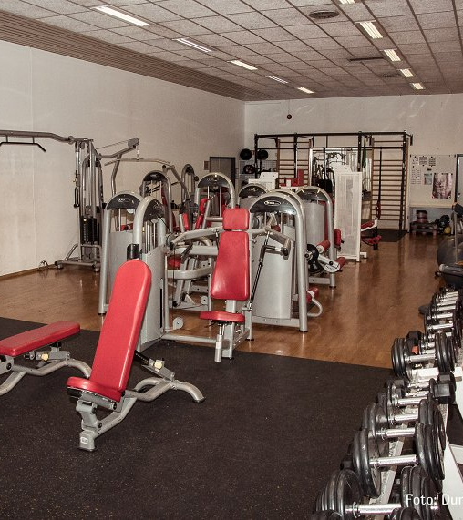
Sports
Center for Extracurricular Activities – FREE sport activities
Contact: University sports hall Rožna dolina, Svetčeva 11, phone 01/241 86 36, cod@uni-lj.si
FB https://www.facebook.com/cod.sportul
INSTA https://www.instagram.com/ul.cod/
WWW https://www.uni-lj.si/extracurricular_activities/

Slide 13
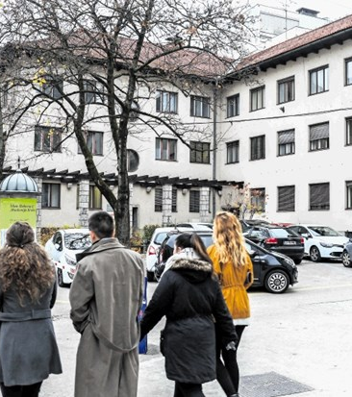
Health problems
If you get sick or have a toothache, you should visit:
ZDRAVSTVENI DOM ZA ŠTUDENTE (Health Centre for students) http://www.zdstudenti.si/en/
Aškerčeva 4, 1000 Ljubljana
Choose a doctor from the list on the web page and call for an appointment or book it online (https://www.zdstudenti.si/en/information-for-patients/appointments/) . You need to bring your European Health Insurance Card or your insurance policy!

Slide 14
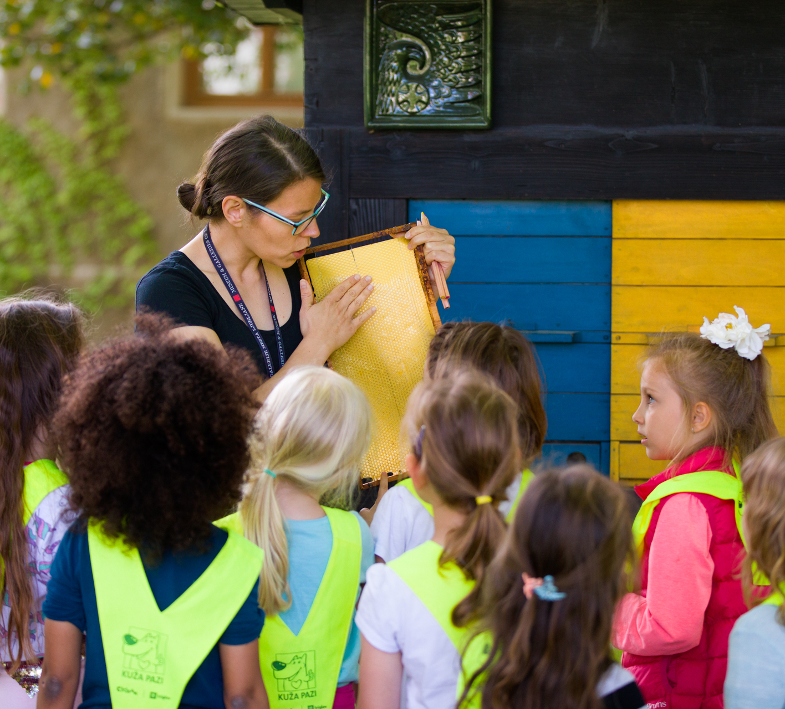
Temporary Student Jobs
You can work via Student Service if you have student status in Slovenia or if you are doing your practice or studies as a part of an international exchange programme in Slovenia https://www.studentski-servis.com/studenti/foreigners
You will have to open bank account in any of the banks here. For opening a bank account, you will need Slovenian tax number.
You can get tax number at Davčni urad Ljubljana

Slide 15

Erasmus Documentation
Confirmation of Stay
Learning agreement
Transcript of Records

Slide 16

Confirmation of Stay
Must be signed on first and last day(!) of mobility.
Used to calculate the Erasmus scholarship based on the number of days on mobility.
If you have your own form, we can sign it. Then you do not need ours.
Real date of departure! Signed in person in the office.

Slide 17

Learning agreement
Changes still possible until March 1, 2024.
Changes have to be requested by e-mail: international@pef.uni-lj.si
Don‘t forget: changes must be approved by your home coordinator as well.

Slide 18

Transcript of Records
Issued at the end of your exchange by the international office; instead of last part of Learning agreement.
You have to order it by email at the international office once you have all the grades in the information system.
Sometimes Erasmus students return home before the grades are in the system.

Slide 19
Other documentation:
Student ID card (on the meeting)
Acceptance Letter (you should alerady have it)
Instructions for activation of your
UL Digital Identity (sent by email)
Personal registration number (EMŠO) (sent by email)
Bus ticket form (sent by email)

Slide 20

Student ID card
The Student ID card of the University of Ljubljana is an official document that gives the exchange student the same rights as to Slovene students. The card is used as an accession to libraries and faculty exams.
Student ID card of the University of Ljubljana can be used for enabling discounts on admission to museums and sights, inexpensive meals in some restaurants and discounts on many forms of transport.

Slide 21
Personal Registration Number (EMŠO)
The EMŠO is a personal identification number in the Republic of Slovenia. It is entered in official records and other databases when so stipulated by the law. You will need it, for example, for buying Urbana student bus card etc.

Slide 22
Your UL Digital Identity
You need the UL ID to access the systems and services during your studies at UL PEF:
  Student Information System - VIS (application for exams, grades)
  UL PEF Online Classroom - Spletna učilnica PEF,
  Use of computers in the lobby of UL PEF,
  Computer classrooms at UL PEF,
  EduRoam wireless internet network
  Services provided to students by the University of Ljubljana: Email, Office 365 (MS Teams!), E-notifications (e-obvestila)
More information: https://www.pef.uni-lj.si/en/exchange-students/information-services-for-students/

Slide 23

Your UL Digital Identity
Your UL digital identity is comprised of your username and your password. The username resembles an email address, e.g. jn1234@student.uni-lj.si.
You must first activate your identity at a special portal - you received your username. Follow the instructions for ID activation!

Slide 24
Student Information System („VIS“)
https://vispef.uni-lj.si/peful_ang/
Use your Digital ID of the University of Ljubljana!
The System includes:
  My Data (Important: please check if you have all your chosen courses enabled in the information system!)
  Exams (exam registration 3 days before the exam!), withdraw from exam, exam dates, exam results)

Slide 25
Virtual Classroom („Moodle“)
https://ucilnice.arnes.si/course/index.php?categoryid=8263&lang=en
Use your Digital ID of the University of Ljubljana!
Virtual Classroom is used by professors in the courses (for literature, assignments etc.)
Some courses are additionally locked by „enrolment key“. Each professor will give it to you.

Slide 26
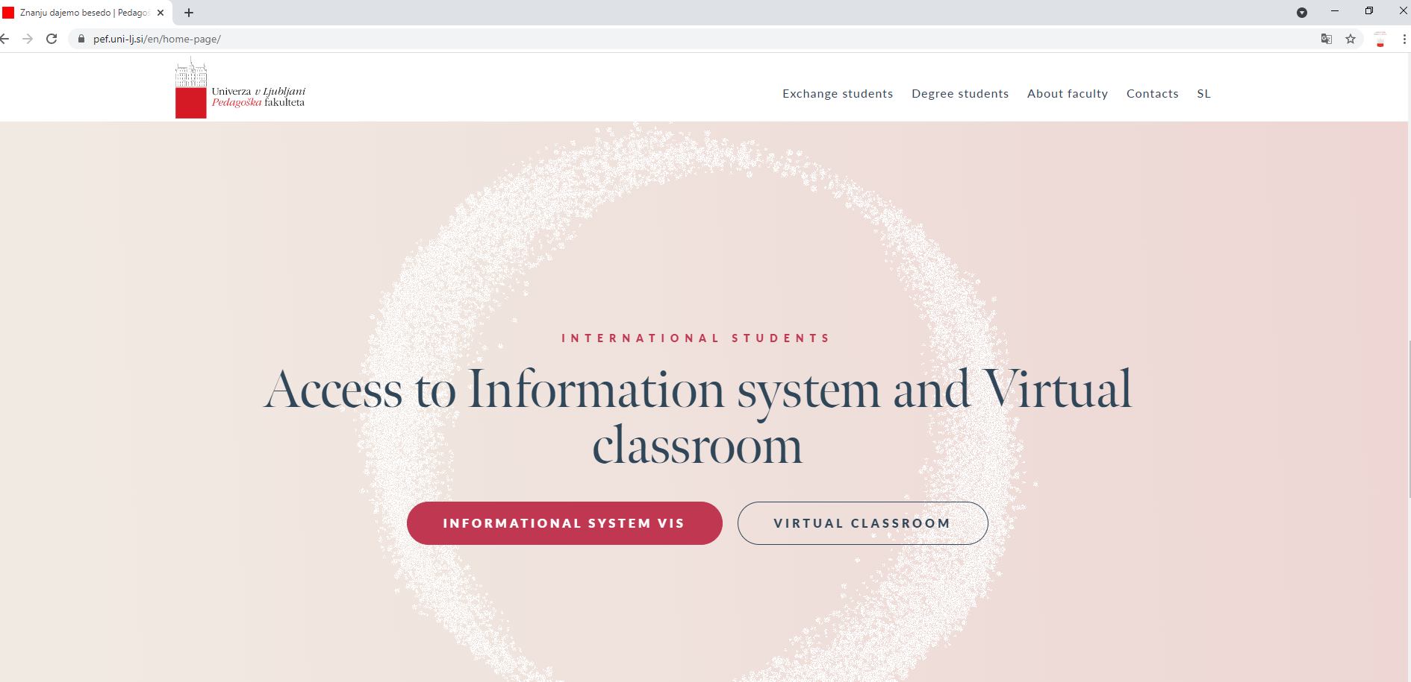
Both links on Homepage

Slide 27
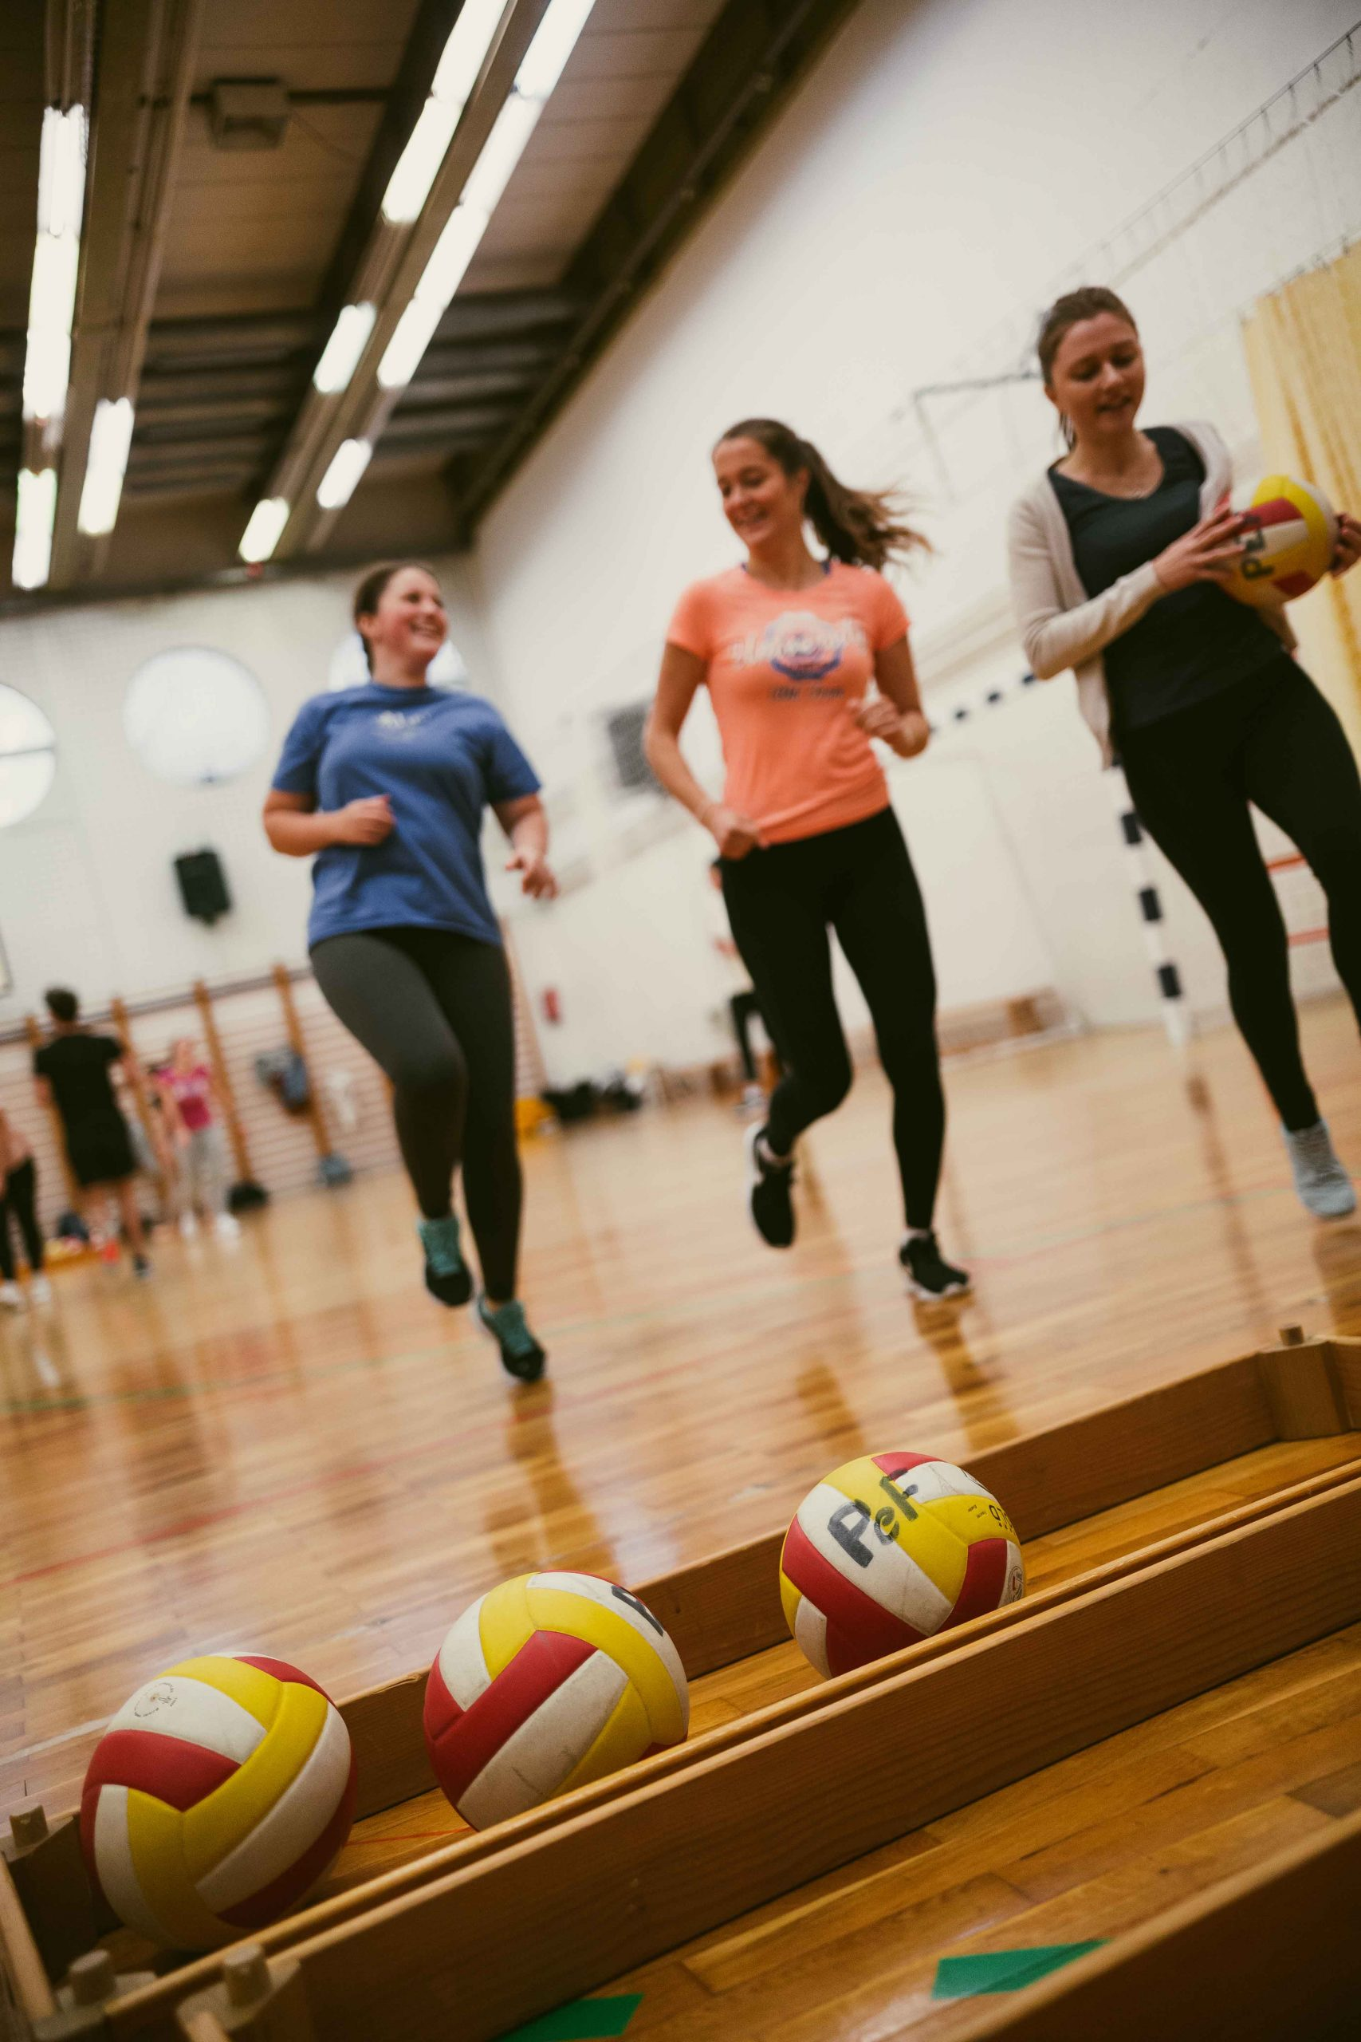
Sport at Faculty of Education
Recreational sport at the Faculty of Education – for further information please contact:
Luka Leitinger
Luka.Leitinger@pef.uni-lj.si

Slide 28
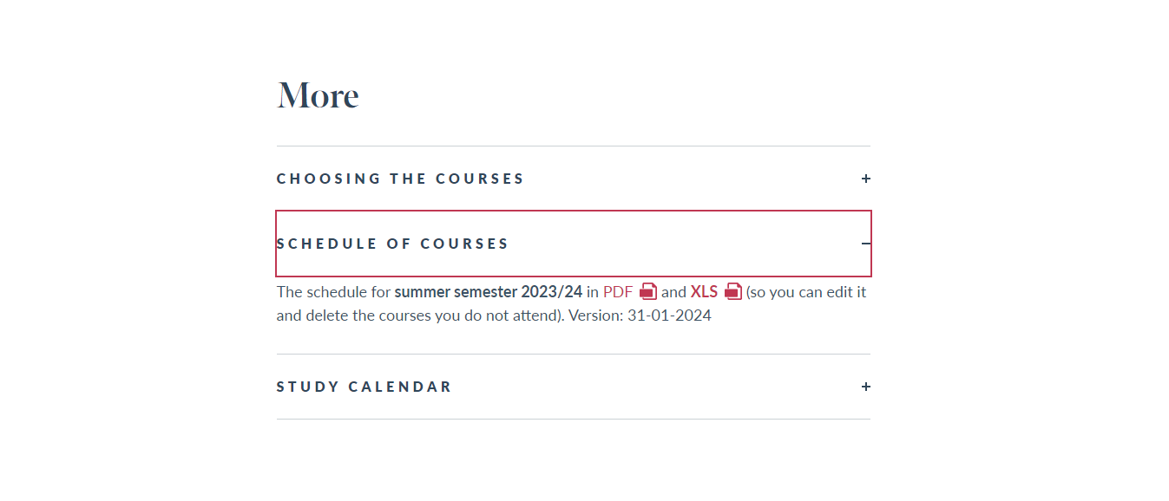
Schedule
https://www.pef.uni-lj.si/en/exchange-students/courses-in-english/

Slide 29
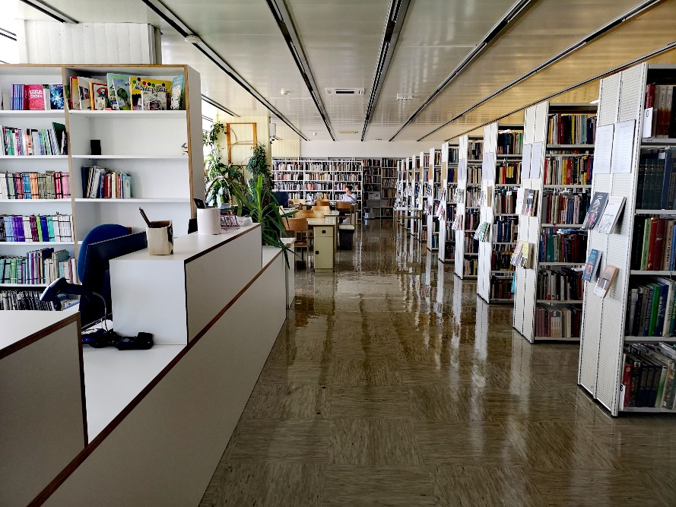


knjiznica.pef
Knjižnica UL PEF
LIBRARY
Librarian for Erasmus students – Milena Repa
milena.repa@pef.uni-lj.si

Slide 30
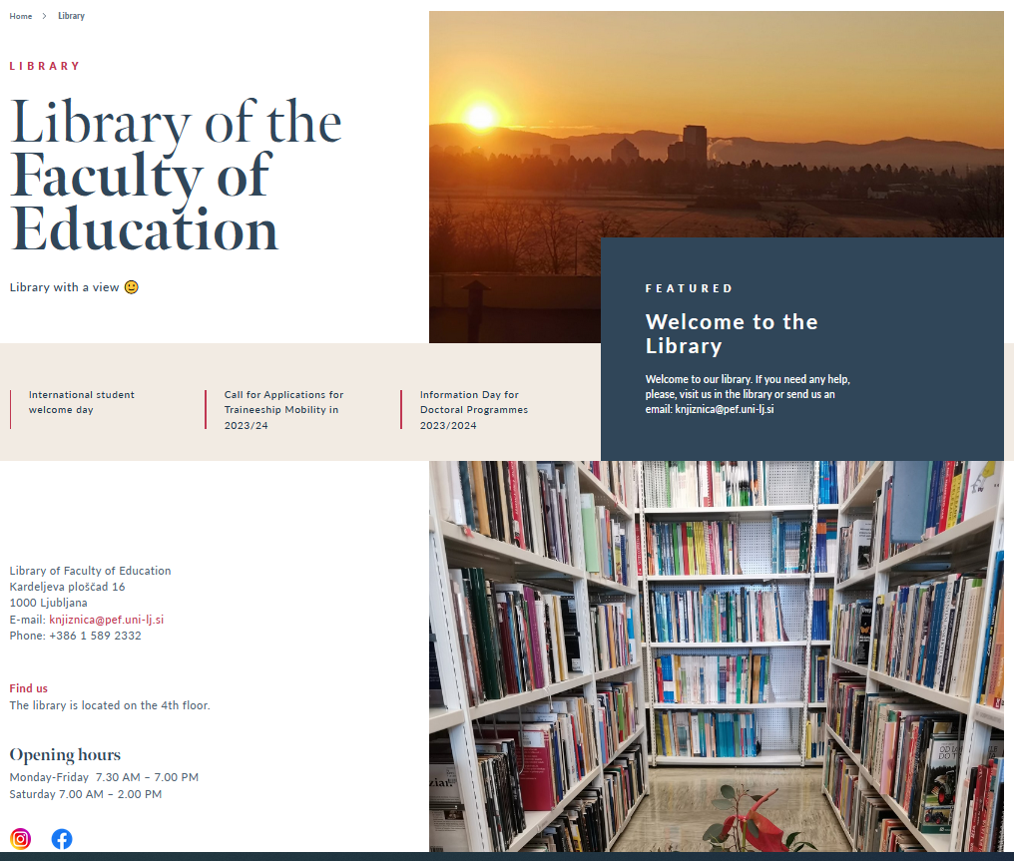
Library
4th floor
Monday to Friday
7.30 – 19.00
Saturday
7.00 – 14.00

Slide 31
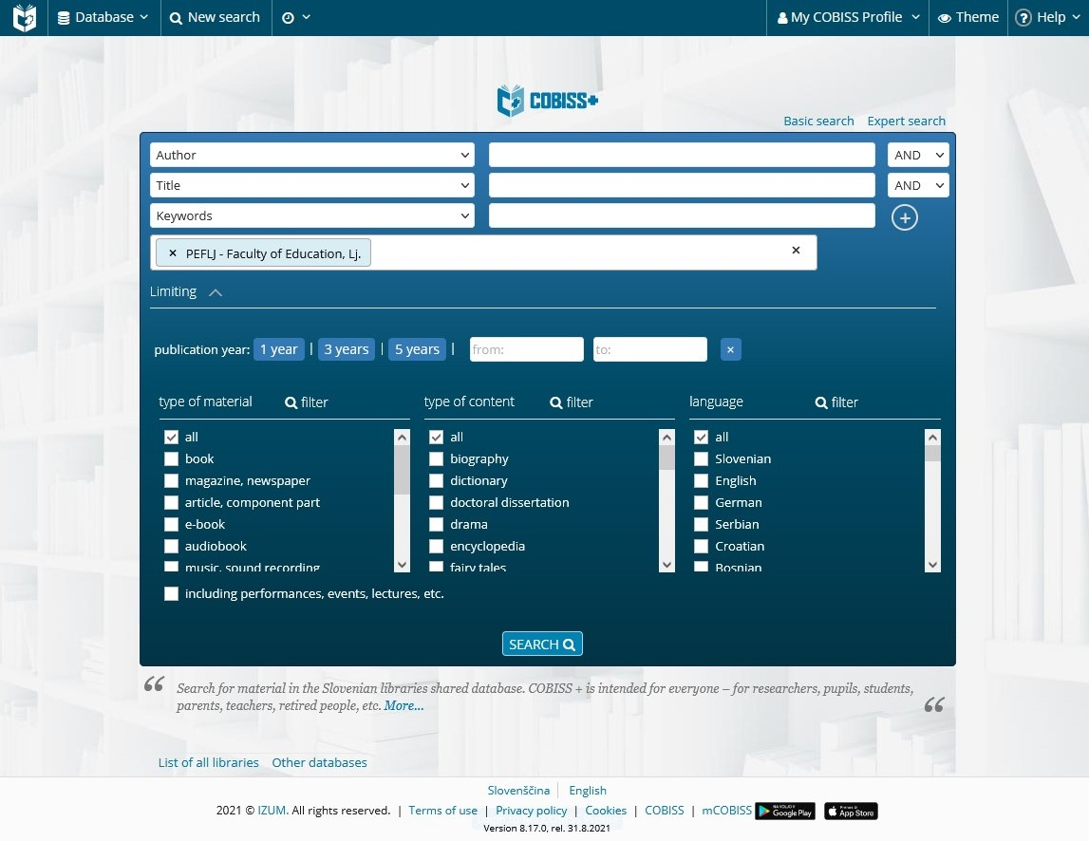
COBISS+
National library management system
Login
Online registration
Choose/write peflj
Your digital identity
Acronym: peflj
Language: English

Slide 32
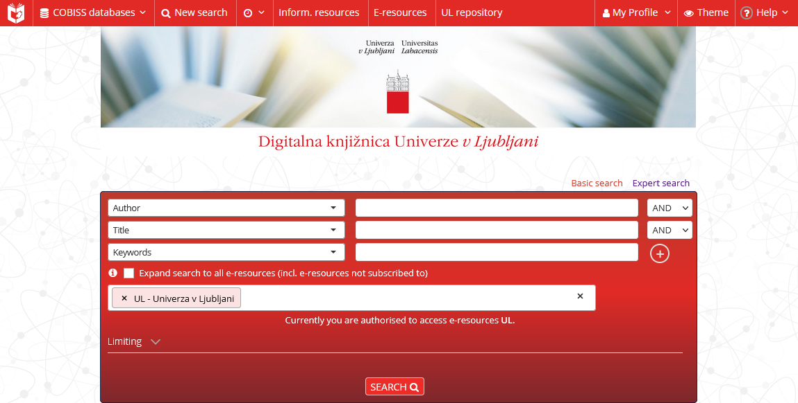
DiKUL - Digital library of University of Ljubljana
Access to foreign (academic) journals and e-books from different academic and scientific fields
Full text articles, open access
Remote access with your digital identity

Slide 33

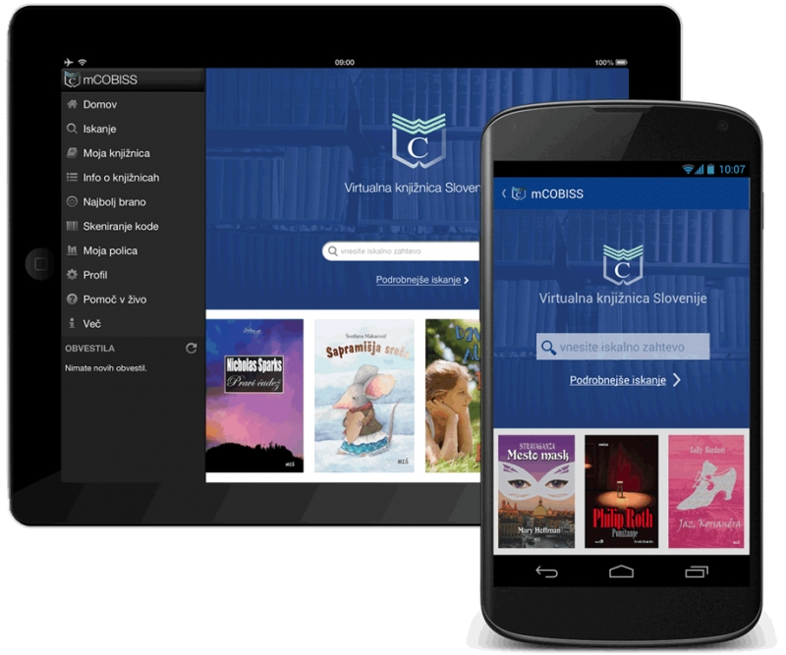


Mobile library catalogue
For reserving or renewing books

Slide 34
LIBRARY EDUCATION SERVICES
Welcome to individual or group training for library use.
We adjust training to individual groups, background knowledge and agreed topic area.
Send us an email on knjiznica@pef.uni-lj.si or ask in the library.

Slide 35
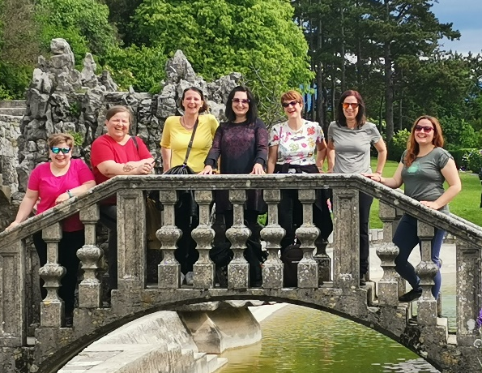
WELCOME TO THE LIBRARY!
Books for leisure time in English
Reading room for studying
Print journals in English
Friendly librarians ☺
knjiznica.pef
Knjižnica UL PEF

