Slide 1
Erasmus Students Welcome Meeting
Ljubljana, 10 February 2023

Slide 2
Erasmus Student Network
ESN Ljubljana University: e-mail: tutor@erasmusljubljana.si or fdv.tutor@gmail.com Web: https://www.erasmusljubljana.si/
Tutor Student at the Faculty of Education: tutorpef@gmail.com

Slide 3
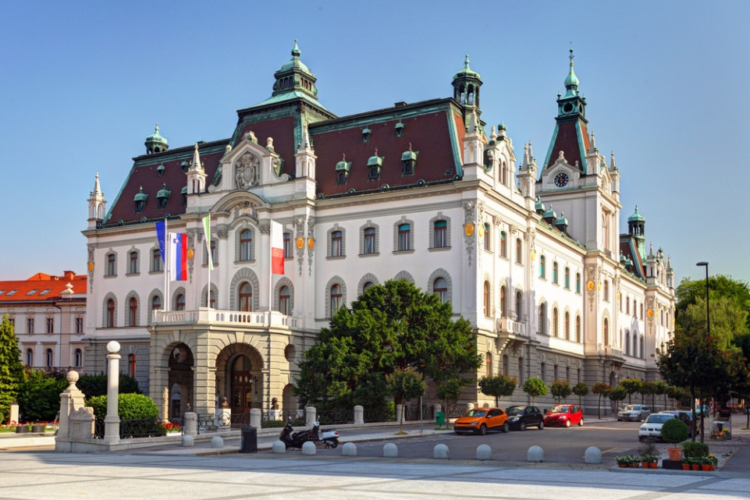
About the University of Ljubljana
Established in 1919.
Among 500 best world's universities on the Shanghai, Times and Webometrics ranking lists.
26 full Members (3 art academies and 23 faculties)
Number of staff: 5.972
Number of students: 48.822

Slide 4
About the Faculty of Education
App. 2.500 students
193 staff (143 teaching staff, 50 administration)
9 departments

Slide 5
About the Faculty of Education
Study Programmes:
• 1ST CYCLE (UNDERGRADUATE STUDY PROGRAMMES)
Preschool Education, Primary Teacher Education, The Two-Subject Teacher, Art Pedagogy, Special and Rehabilitation Pedagogy, Visually Impaired Education and the Pedagogy of Specific Learning Difficulties, Social Pedagogy
• 2ND CYCLE (MASTER STUDY PROGRAMMES)
Preschool Education, Primary Teacher Education, Primary Teacher education with English specialisation, Subject Teacher Education, Art Pedagogy, Special and Rehabilitation Pedagogy, Speech and Language Therapy, Social Pedagogy, Supervision, Personal and Organisational Counselling, Cognitive Science (Joint Degree), Arts Therapy, Museum Education, Educational Policies
• 3RD CYCLE (DOCTORAL STUDY PROGRAMME)
Teacher Education and Educational Science

Slide 6
Office for International Co-operation
Room 034
Tel: +386 1 5892 346
Fax: +386 1 5892 233
E-mail: international@pef.uni-lj.si
Opening hours:
Monday and Friday 8:30 - 11:30
Wednesday 12:30 - 15:30
Igor Repac
Robert Gracar

Slide 7
Practical Information
WELCOME MEETING FOR FOREIGN STUDENTS (15 September 2022) - recording of the zoom welcome meeting with practical information on residence permit, student meals, urbana card ....
https://www.uni-lj.si/study/news/reception/

Slide 8
First Residence Permit:
If you are staying in Slovenia for more than 3 month you have to apply for the First Residence Permit (and report your temporary address if you are staying in a private flat) as soon as possible after the arrival.
You should go to the Administration Unit (Upravna enota), Tobačna ulica n. 5, 1000 Ljubljana. A special reception desk for exchange students will be open from 9 February 2023 to 28 February 2023 between 8.00 am and 2.30 pm (Fridays form 8 am – 12.30pm). Please report to the security officer at the MAIN ENTRANCE at TOBAČNA ULICA 5 and prepare all the relevant documentation required for the issue of the temporary residence permit. In case there are too many students and you don't get your turn, you will be asked to visit the Administrative office on another day.
You can also apply out of these days within 90 days after your arrival to Ljubljana, at the regular time and place of the office for foreigners, Tobačna 5.
See the email instructions (sent on February 7) >>

Slide 9
Student meals (from 13. 2. 2023)
1. You need your mobile phone with mobile data or Slovene SIM card. (Free SIM cards should also be available at the Student Organization of the University – ŠOU, Pivovarniška 6, Kampus, office hours Monday, Tuesday, Thursday: 16.00 - 19.00); you can also get a special card used only for the food system – 15€ non-refundable, 1-2 days to be operative;
2. Register on-line: www.studentska-prehrana.si
3. For the final registration go to INFO Point at Pivovarniška 6, (Mon 9am-3.30pm, Wed 9am-3.30pm); e-mail contact: studentska.prehrana@sou-lj.si or ESN office (Pivovarniška
6 – pink door)
You also need EMŠO number (unique personal number – 13 digit number starting with your date of birth) – provided by the faculty- please contact your faculty coordinator https://www.uni-lj.si/international_cooperation_and_exchange/erasmus-plus-programme/erasmus_plus_coordinators/
You will get app. 20 subsidies per month. You can use the system twice a day (4 hours break between the meals), from 8am until 9pm, also during weekends.

Slide 10
STUDENT BUS CARD (URBANA TIME CARD - green)
- 20 € per month (the pass is valid from the first day of the month until the first day of the next month, ex. 1 October -1 November)
- With special form: Subsidized monthly pass application form, filled in and equipped with EMŠO number, go to this address: Slovenska cesta 56, Ljubljana – office hours: 6.30 am – 7 pm, or main Bus Station, Trg OF 4, 6 am – 8 pm. You don’t need the signature or stamp of the faculty!
If you think you will not use the bus often, you can get Urbana value card – yellow (one ride costs 1.30€) – you can purchase it in any kiosk or at the post office. The card itself costs 2€. http://www.jhl.si/en/single-city-card-urbana

Slide 11
SELF-SERVICE BIKE BORROWING SYSTEM “BICIKElj” for only 3 EUR/year
Easiest way to travel around Ljubljana is with free-of-charge bicycle rental Bicikelj, it requires prior registration at http://en.bicikelj.si/ and any kind of Urbana card.

Slide 12
Centre for Extracurricular Activities FREE sport activities
Contact: University sports hall Rožna dolina, Svetčeva 11, phone 01/241 86 36, cod@uni-lj.si
FB https://www.facebook.com/cod.sportul
INSTA https://www.instagram.com/ul.cod/
WWW https://www.uni-lj.si/obstudijske_dejavnosti/sport/

Slide 13
Erasmus Documentation
Confirmation of Stay
Learning agreement
Transcript of Records

Slide 14
Confirmation of Stay
Must be signed on first and last day(!) of mobility.
Used to calculate the Erasmus scholarship based on the number of days on mobility.
If you have your own form, we can sign it. Then you do not need ours.
Real date of departure!

Slide 15
Learning agreement
Changes still possible until February 24.
Changes have to be requested by e-mail: international@pef.uni-lj.si
Don‘t forget: changes must be approved by your home coordinator as well.

Slide 16
Transcript of Records
Issued at the end of your studies by the international office.
You have to order it by email at the international office once you have all the grades in the information system.
Sometimes Erasmus students return home before the grades are in the system.

Slide 17
Other documentation:
Student ID card (on the meeting)
Acceptance Letter (you should alerady have it)
Instructions for activation of your UL Digital Identity (by email after the meeting)
Personal registration number (EMŠO) (by email after the meeting)
Confirmation of Stay form (in person in office or by email)
Bus ticket form (on the meeting)

Slide 18
Student ID card
The Student ID card of the University of Ljubljana is an official document that gives the exchange student the same rights as to Slovene students. The card is used as an accession to libraries and faculty exams.
Student ID card of the University of Ljubljana can be used for enabling discounts on admission to museums and sights, inexpensive meals in some restaurants and discounts on many forms of transport.

Slide 19
Personal Registration Number (EMŠO)
The EMŠO is a personal identification number in the Republic of Slovenia. It is entered in official records and other databases when so stipulated by the law. You will need it, for example, for buying Urbana student bus card etc.

Slide 20
Your UL Digital Identity
You need the UL ID to access the systems and services during your studies at UL PEF:
Student Information System - VIS (application for exams, examination of grades, schedules)
UL PEF Online Classroom - Spletna učilnica PEF,
Use of computers in the lobby of UL PEF,
Computer classrooms at UL PEF,
EduRoam wireless internet network
Services provided to students by the University of Ljubljana: Email, Office 365 (MS Teams!), E-notifications (e-obvestila)
More information: https://www.pef.uni-lj.si/en/exchange-students/information-services-for-students/

Slide 21
Your UL Digital Identity
Your UL digital identity is comprised of your username and your password. The username resembles an email address, e.g. jn1234@student.uni-lj.si.
You must first activate your identity at a special portal - you will receive your username. Follow the instructions for ID activation!

Slide 22
Student Information System („VIS“)
https://vis.pef.uni-lj.si/peful_ang/ Use your Digital ID of the University of Ljubljana!
The System includes:
My Data (Important: please check if you have all your chosen courses enabled in the information system!)
Exams (exam registration 3 days before the exam!), withdraw from exam, exam dates, exam results)
Don‘t confuse this with Virtual Classroom!

Slide 23
Virtual Classroom („Moodle“)
https://ucilnice.arnes.si/course/index.php?categoryid=8263 Use your Digital ID of the University of Ljubljana!
Virtual Classroom is used by professors in the courses (for literature, assignments etc.)
Some courses are additionally locked by „enrolment key“. Each professor will give it to you.
Don‘t confuse this with Student Information system!

Slide 24
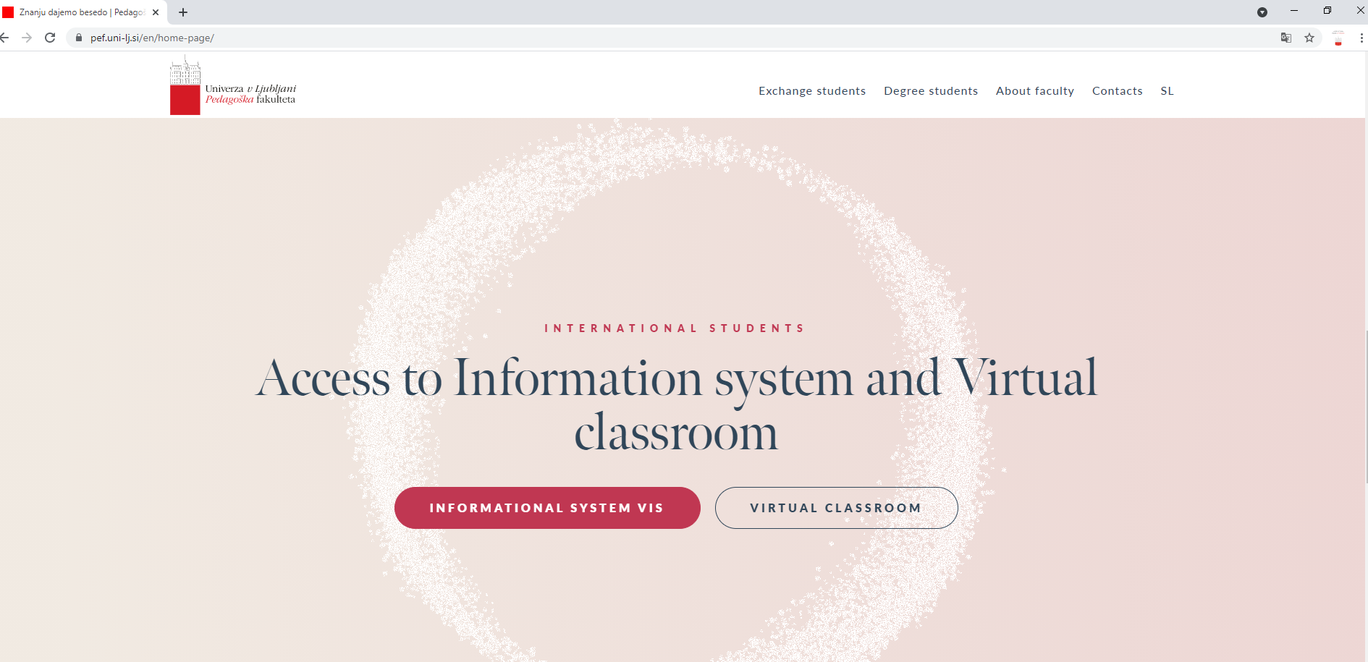
https://www.pef.uni-lj.si/en/home-page/

Slide 25
Erasmus Day
Erasmus Day – presentation of Erasmus students and countries they are coming from. Preparation of national dishes in cooperation with Slovenian professors & students.

Slide 26
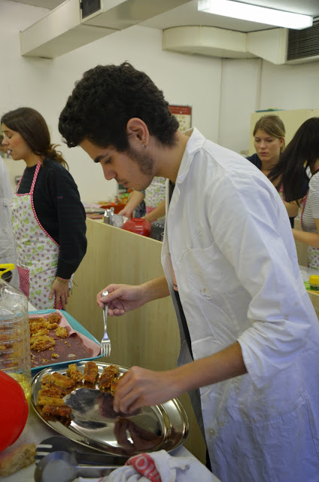
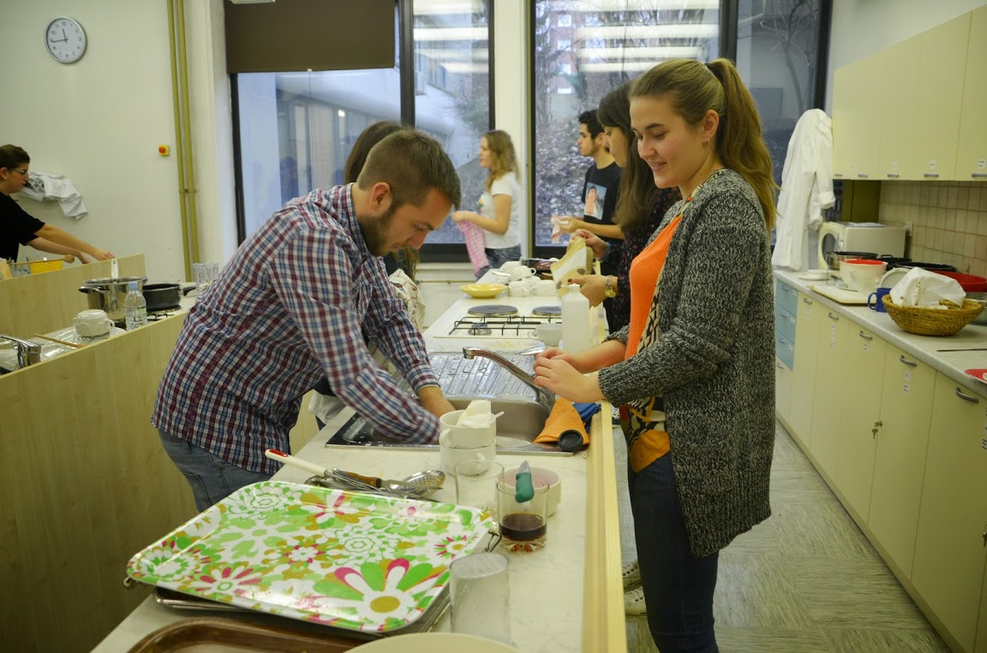

Slide 27
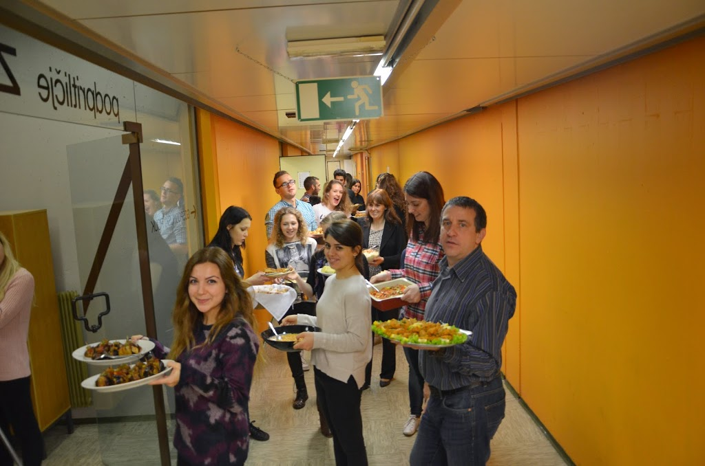
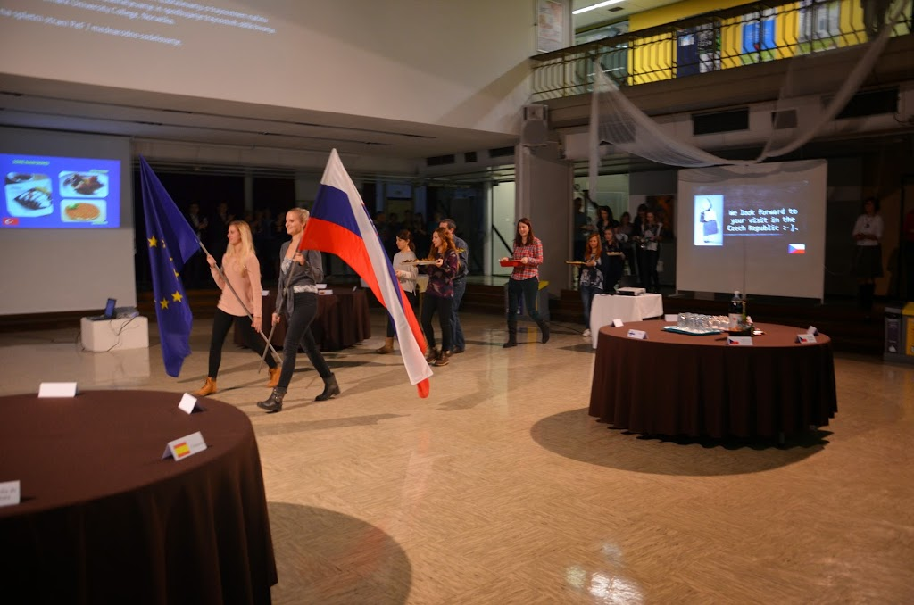

Slide 28
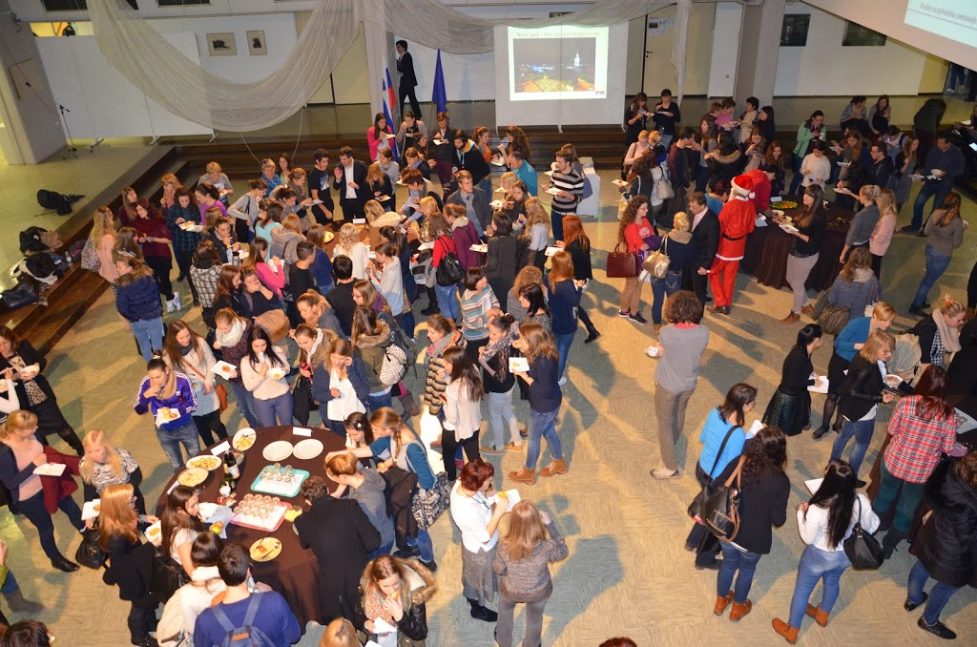

Slide 29
Sport
Recreational sport at the Faculty of Education – for further information please contact:
Luka Leitinger
Luka.Leitinger@pef.uni-lj.si

Slide 30
Health problems
If you get sick or have a toothache, you should visit:
ZDRAVSTVENI DOM ZA ŠTUDENTE (Health Centre for students) http://www.zdstudenti.si/en/
Aškerčeva 4, 1000 Ljubljana
Choose a doctor from the list on the web page and call for an appointment or book it online (https://www.zdstudenti.si/en/information-for-patients/appointments/). You need to bring your European Health Insurance Card or your insurance policy!
COVID-19 – if you experience any signs of Covid-19 you should use the self-test to prove it and self-isolate. Free self-tests (10 per month) for students are available in any pharmacy. You should have your EMŠO number, your personal document and university student card.

Slide 31
SHEDULE
https://www.pef.uni-lj.si/en/exchange-students/courses-in-english/

Slide 32
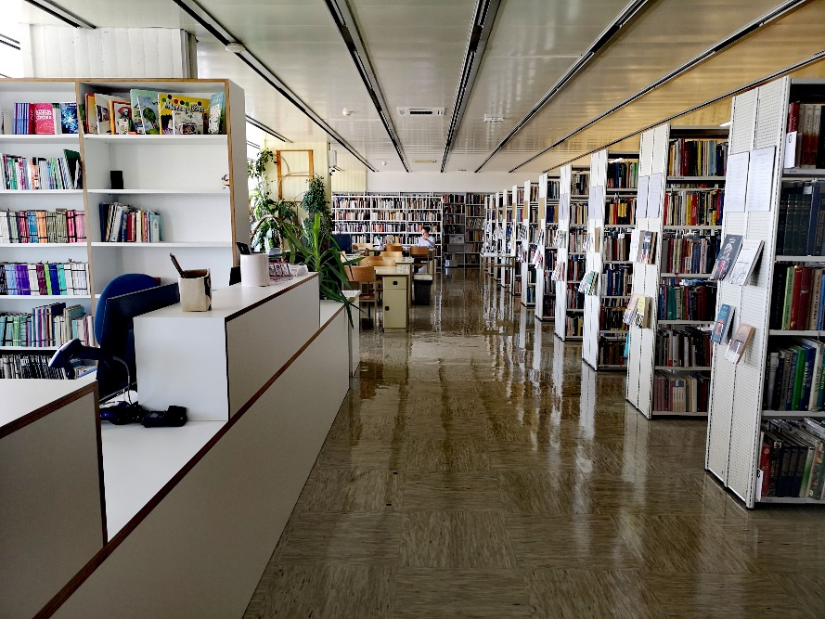
LIBRARY
Librarian for Erasmus students – Milena Repa
milena.repa@pef.uni-lj.si

Slide 33
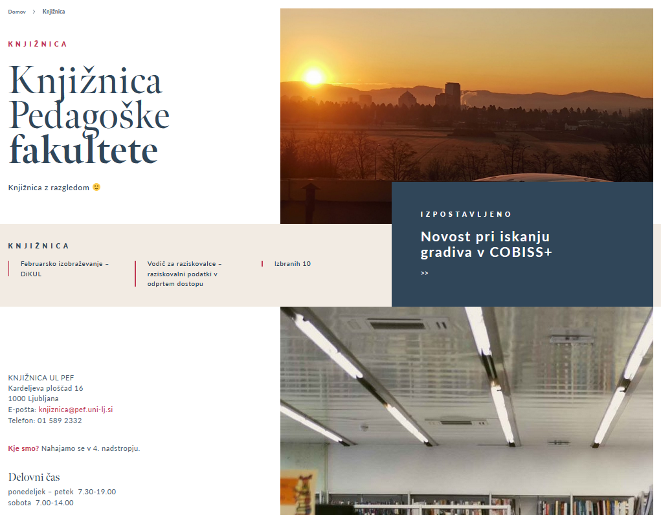
Library
4th floor
Monday to Friday
7.30 – 19.00
Saturday
7.00 – 14.00

Slide 34
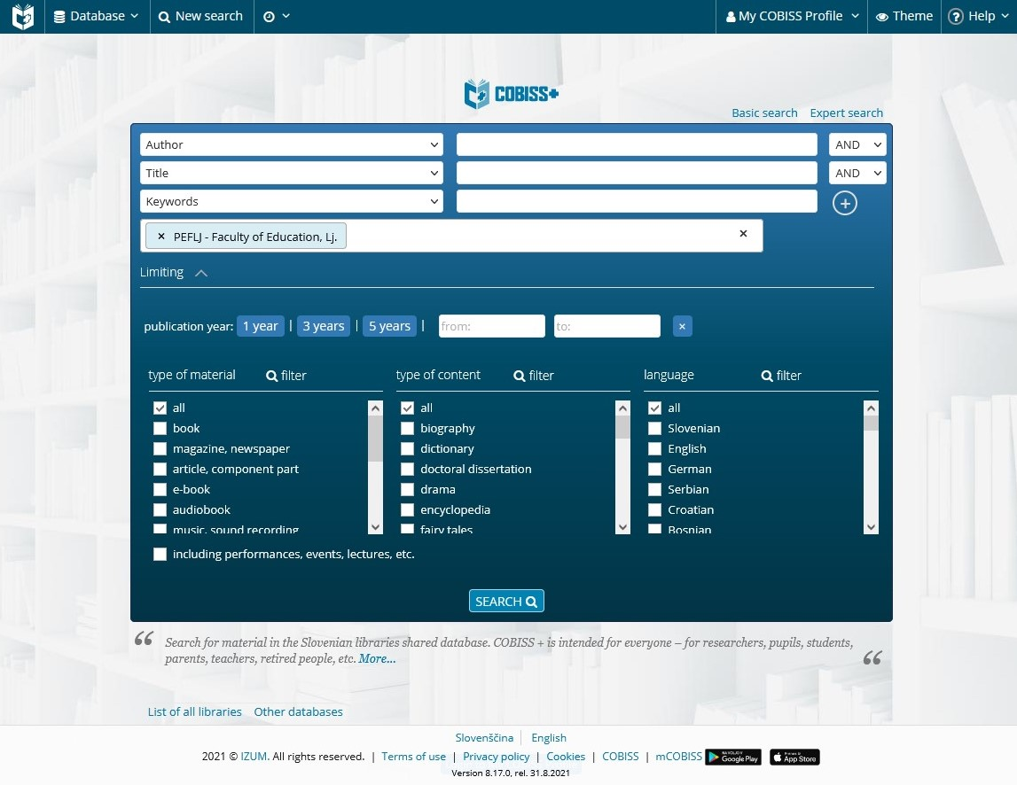
COBISS+ National library management system
Login
Online registration
Choose/write peflj
Your digital identity
Acronym: peflj
Language: English

Slide 35
DiKUL - Digital library of the University of Ljubljana
Access to foreign (academic) journals and e-books from different academic and scientific fields
Full text articles, open access
Remote access with your digital identity

Slide 36
Mobile library catalogue
For reserving or renewing books

Slide 37
LIBRARY EDUCATION SERVICES
Welcome to individual or group training for library use.
We adjust training to individual groups, background knowledge and agreed topic area.
Send us an email at knjiznica@pef.uni-lj.si or ask at the library.

Slide 38
WELCOME TO THE LIBRARY!
Books for leisure time in English
Reading room for studying
Print journals in English
Friendly librarians ☺

